Slide 1

EN TID PRÄGLAD AV DIGITAL FÖRVANDLING
Mobilt slår stationärt, sociala medier slår sökning, messaging-appar utmanar e-post och allt omkring oss bli anslutet.

Slide 2

FRAMTIDENS FRÖN HAR REDAN BÖRJAT GRO

Slide 3
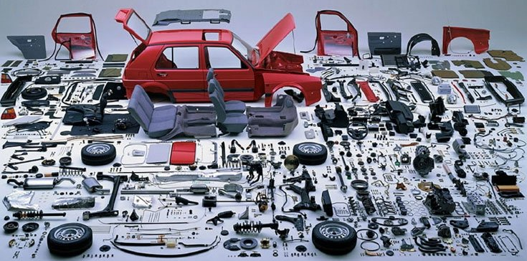
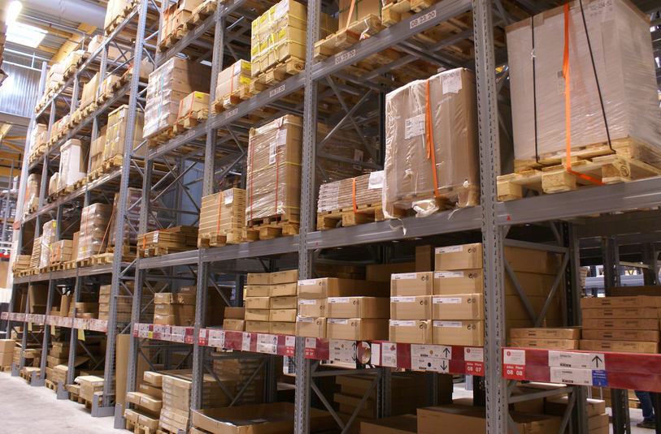
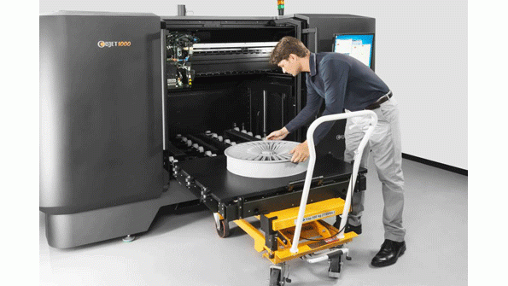

Slide 4


Malware Downloads
Every 4 secs
Unknown malware is downloaded
Every 81 secs
89%
Known malware is downloaded
of organizations
Notes:
In 2015, we observed that 89 percent of the organizations we analyzed attempted download a malicious file. This is a significantly increase from the 63 percent in 2014.
Every 4 seconds, an organization downloads a new piece of unknown malware. This happens because most organizations do not have protections in place to stop them. That is more than a 800 percent increase from last year, when unknown malware was downloaded every 34 seconds. Likewise in 2015, organizations download known malware every 81 seconds, compared to every 6 minutes in 2014, another significant increase.

Slide 5
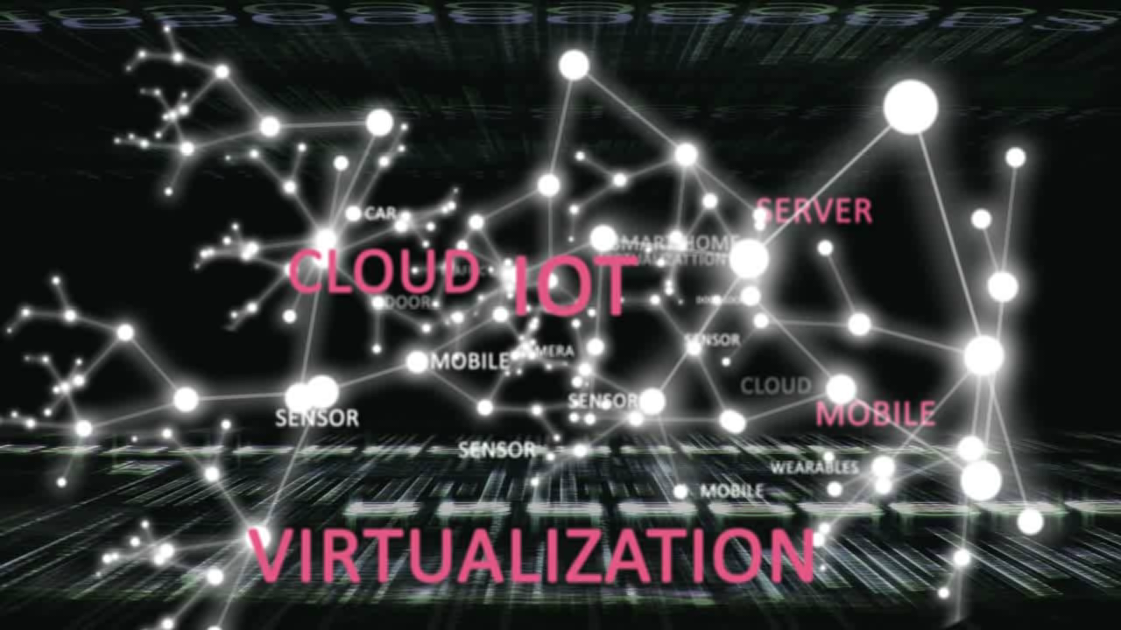
ATT LIGGA STEGET FÖRE INNEBÄR
BLOCKERA ATTACKER ÖVERALLT
PREVENTION
ACROSS
ALL
BUSINESS
PLATFORMS
Notes:
We protect all the new and emerging business platforms whether they are: physical and virtual networks, desktop, mobile, cloud, and IoT.

Slide 6
Sunet 2017
Bygg en säkrare infrastruktur med bibehållen öppenhet
Fredrik Johansson, Security Expert Team Leader

Slide 7
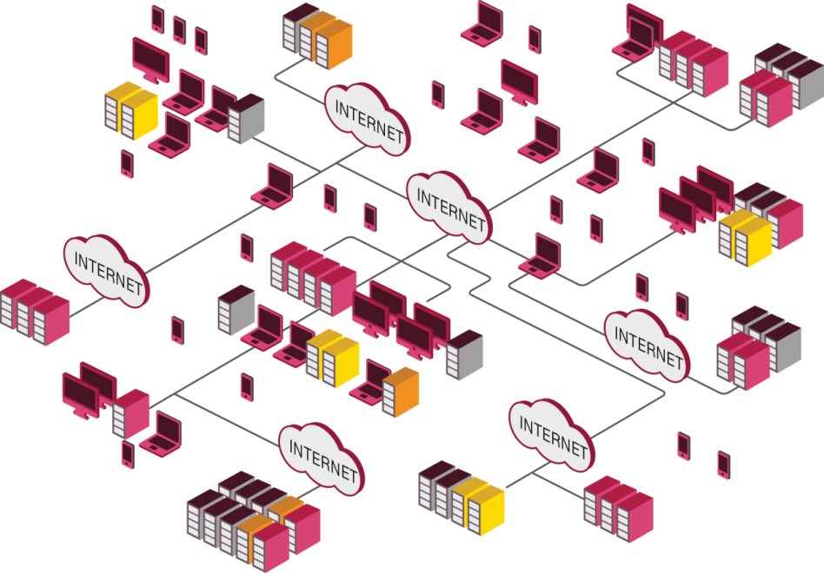
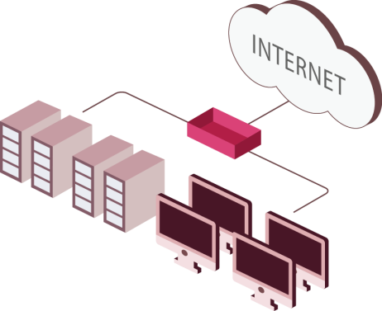
Mer och mer komplexa miljöer
IT-miljön utvecklas med allt fler nya teknologier

Slide 8

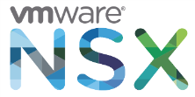
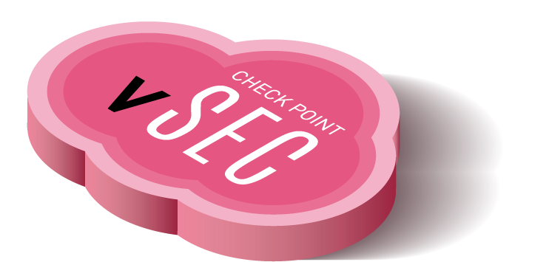






SKYDDA MOLNET
ADVANCERAD SÄKERHET FÖR
ALL DATACENTER-TRAFIK
ACI
AUTOMATISERAD SÄKERHET FÖR “HYBRID CLOUD”
Notes:
Another fast growing technology is public and private cloud. We see more companies using Amazon AWS and Microsoft Azure public cloud platforms. We also see more companies moving to private cloud environments. Very advanced cloud technologies from Cisco ACI, VMware NSX, OpenStack and others are helping more organizations migrate to cloud computing. These cloud environments are not stand-alone. They're extensions of existing infrastructures.
Check Point protects cloud the same way we protect physical networks; our security is platform-agnostic. You can secure and manage a physical network and a cloud environment with the same management and the same policies.

Slide 9
HUR SKYDDAR OCH MANAGERAR
MAN EN FÖRÄNDERLIG MILJÖ?

Slide 10
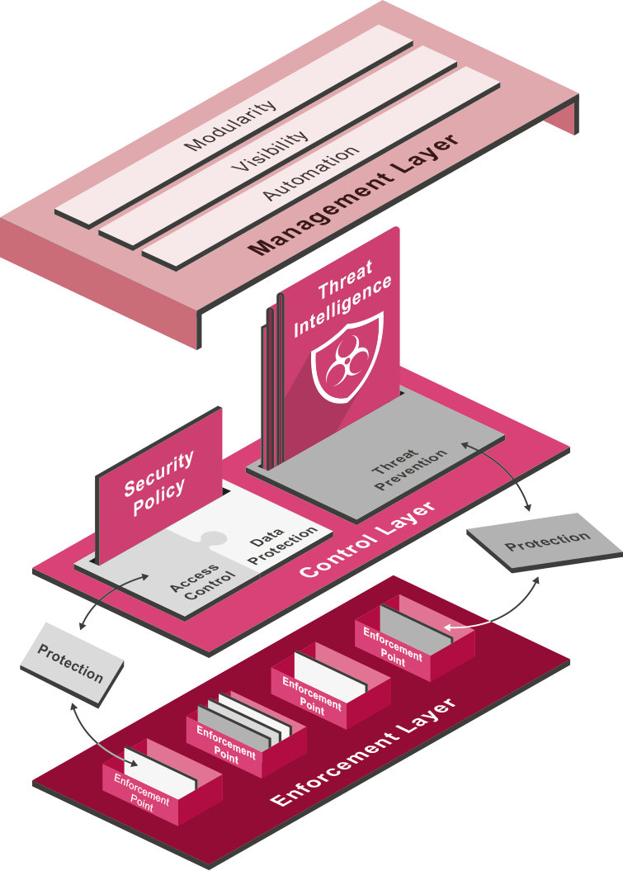
Introducing
SOFTWARE –DEFINED PROTECTION
Today SECURITY for Tomorrow’s THREATS

Slide 11
SOFTWARE – DEFINED PROTECTION
MANAGEMENT LAYER
Integrates security with business
process
CONTROL LAYER
Delivers real-time protections to the
enforcement points
ENFORCEMENT LAYER
Inspects traffic and enforces protection
in well-defined segments

Slide 12

ENFORCEMENT LAYER
RELIABLE and FAST to deal with demanding
IT networks and hosts.
[Confidential] For designated groups and individuals

Slide 13
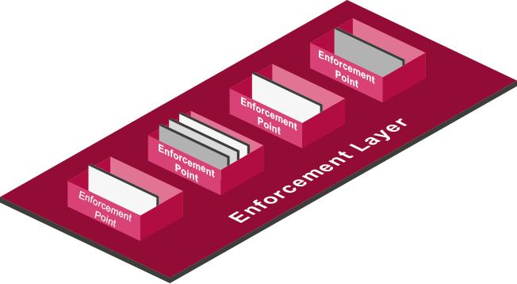
ENFORCEMENT LAYER
Enforcement points MEDIATE interactions between users and systems
and EXECUTE protections
CLOUD SECURITY
MOBILE SECURITY
NETWORK SECURITY GATEWAY
ENDPOINT SECURITY
VIRTUAL SYSTEMS

Slide 14
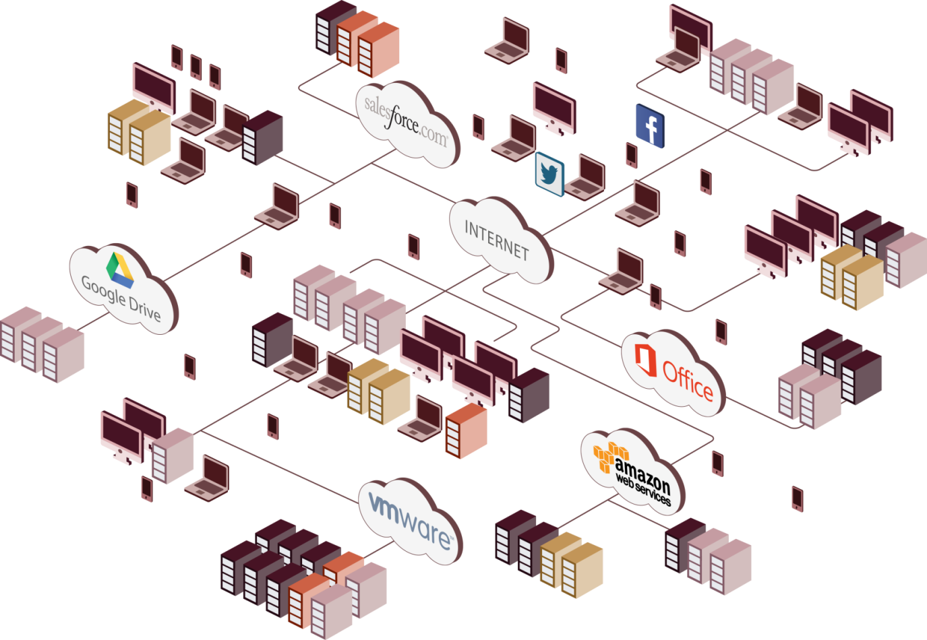
HOW TO PROTECT
BOUNDLESS ENVIRONMENTS?

Slide 15
SEGMENTATION IS THE NEW PERIMETER
In today’s NETWORKS, there is no single perimeter.
Smartphones, clouds, and cloud move DATA and networks
across boundless computing environments.
[Confidential] For designated groups and individuals

Slide 16
SEGMENTATION METHODOLOGY
ATOMIC SEGMENTS
STEP 1
Elements that share the same policy and
protection characteristics
SEGMENT GROUPING
STEP 2
Grouping of atomic segments to allow
modular protection
CONSOLIDATION
STEP 3
Protect interactions and data flow
between segments
TRUSTED CHANNELS
STEP 4
Of physical and virtual components, as network
security gateways or as host-based software

Slide 17
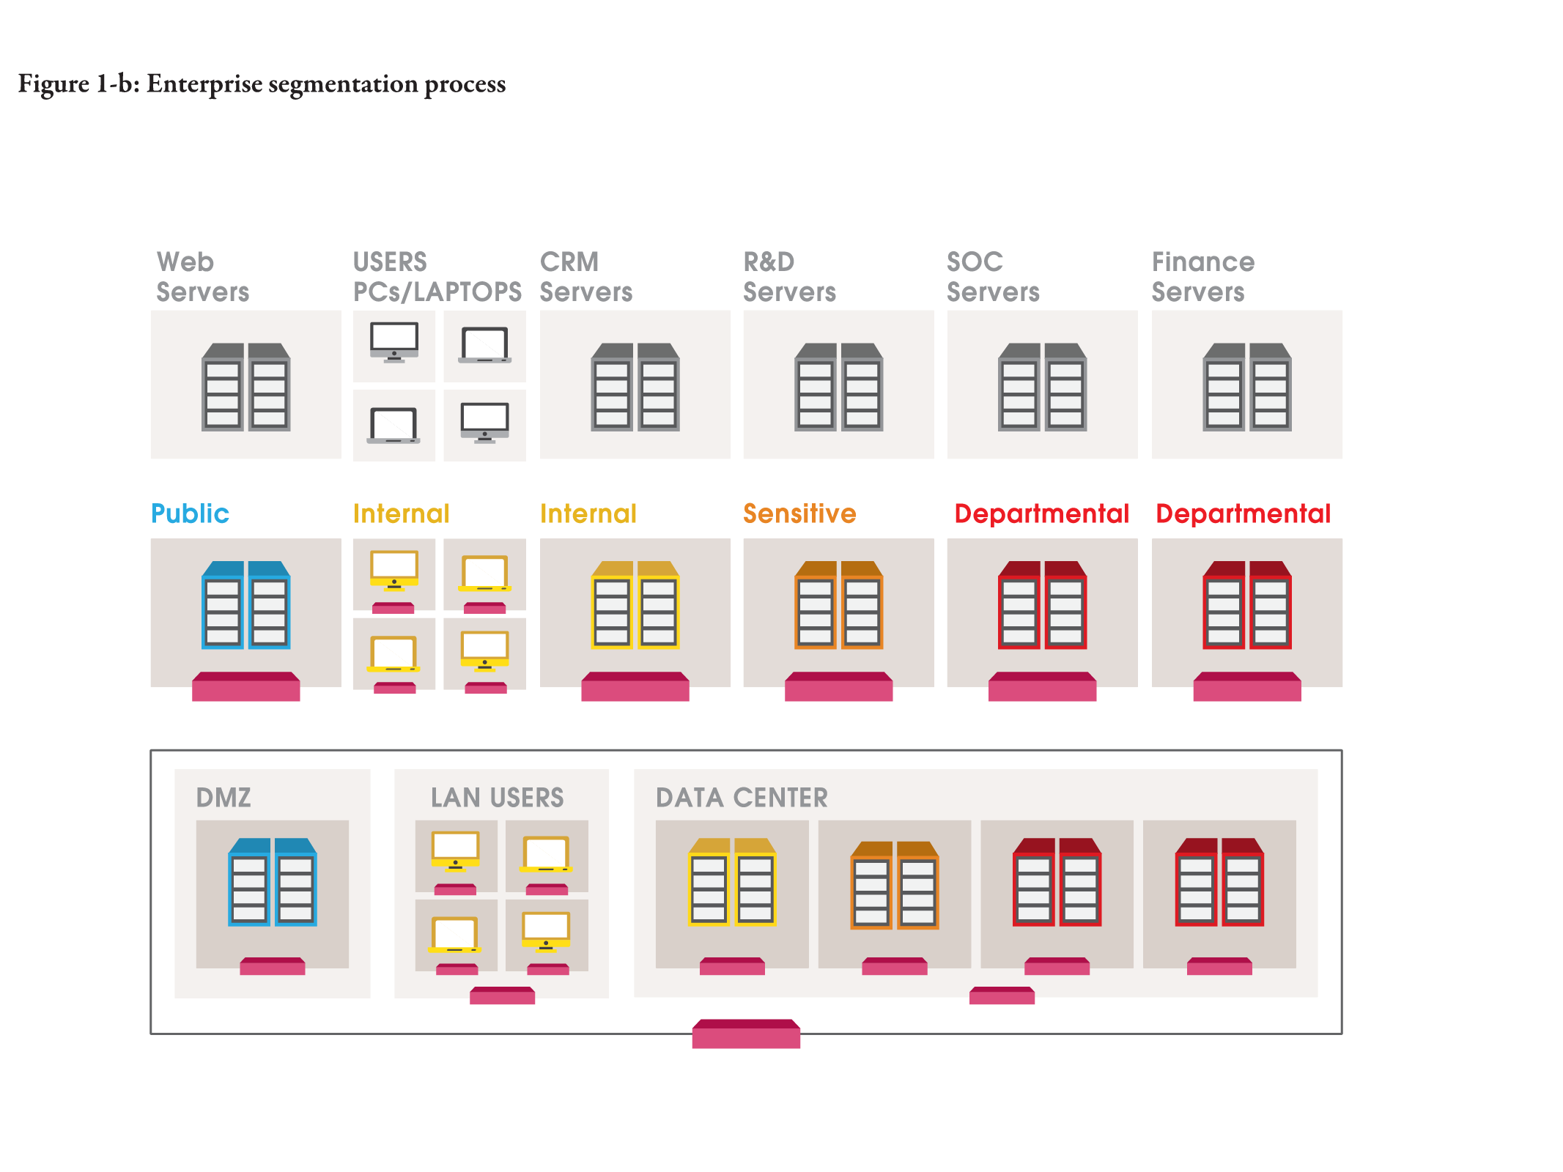
SEGMENTING YOUR NETWORK
Atomic segment
Group of Segments
Consolidation

Slide 18
CONTROL LAYER
Generates SOFTWARE-DEFINED protections and deploys
them at the appropriate ENFORCEMENT points.
[Confidential] For designated groups and individuals

Slide 19
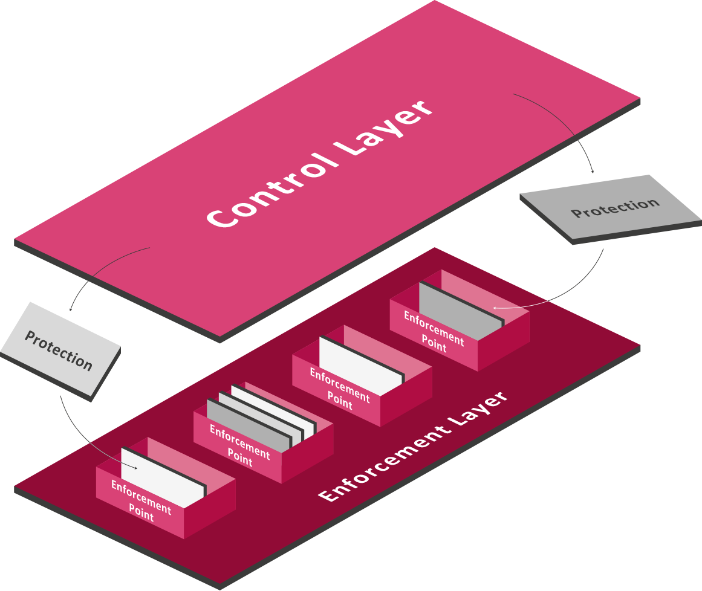
CONTROL LAYER
Generate PROTECTIONS

Slide 20
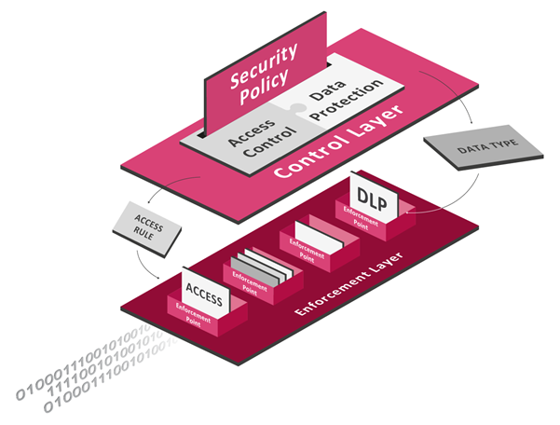
ACCESS CONTROL AND
DATA PROTECTION
Control interactions
between users, assets,
data and applications
Protect data in
motion and at rest

Slide 21







NEXT GENERATION FIREWALL
Controls interactions between USERS, ASSETS, DATA and APPLICATIONS

Slide 22
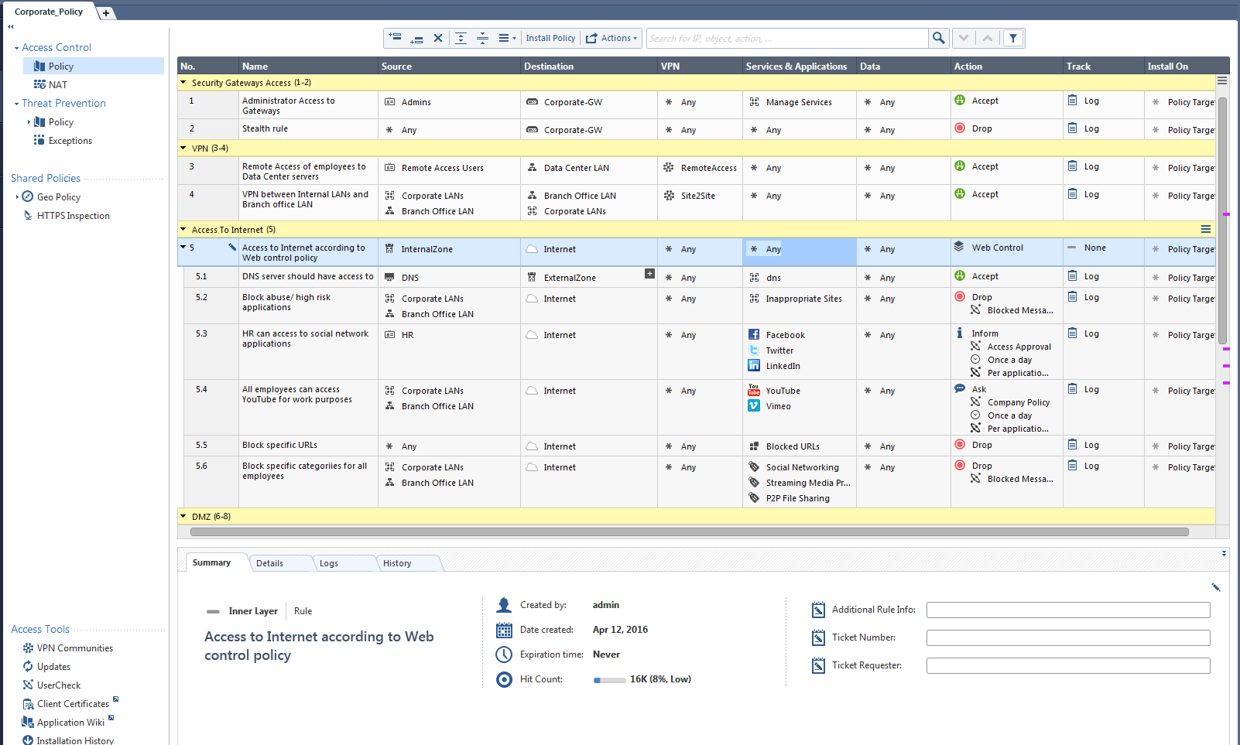
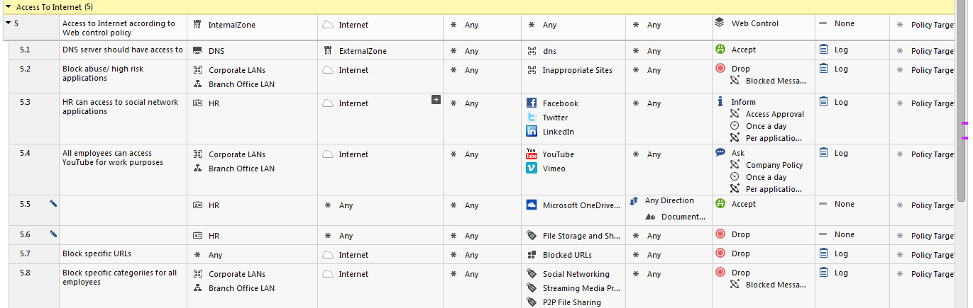

Slide 23
MOST ORGANIZATIONS ARE
USING FIREWALLS TODAY
AND IT WORKS QUITE
WELL…
BUT…

Slide 24

WHAT ABOUT PROTECTING AGAINST
THE BAD GUYS?
[Confidential] For designated groups and individuals

Slide 25
THE THREATS WE NEED TO PREVENT
Know
Knows
Know
Unknowns
Unknown
Unknowns
Threats we
know we know
Threats we know we
don’t know
Threats we don’t
know we
don’t know
ANTI VIRUS
THREAT EMULATION
ANTI BOT
ANTI BOT
IPS

Slide 26
WHAT IS NEEDED?

Slide 27
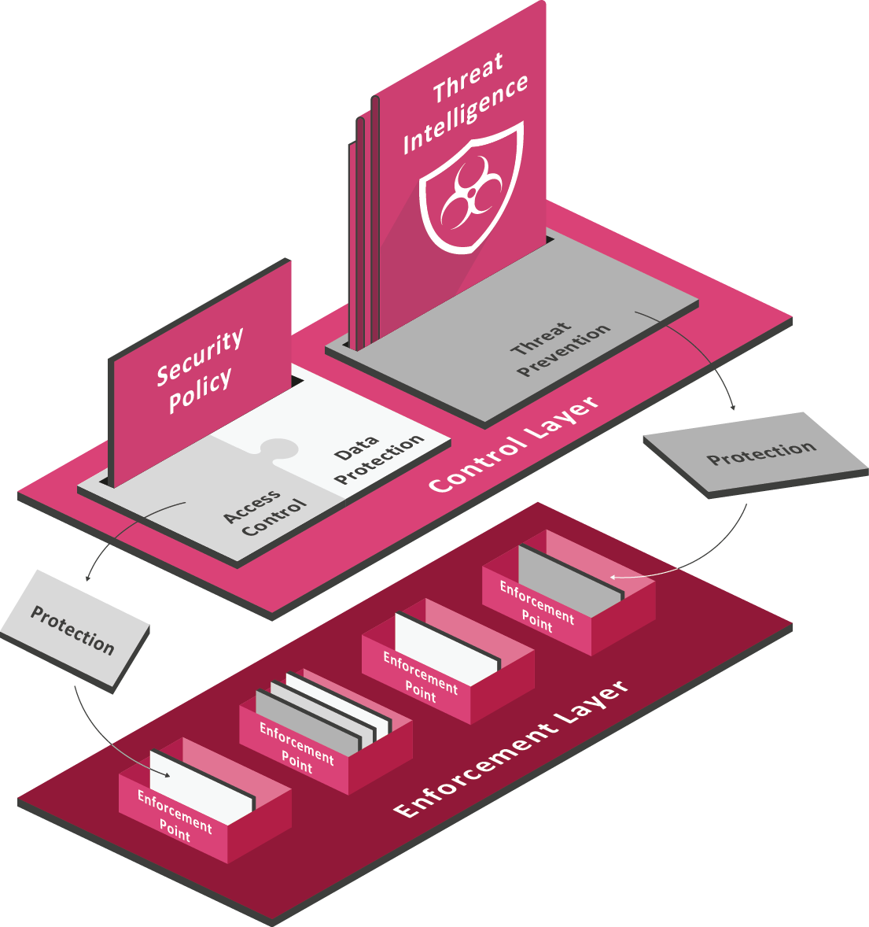
THREAT PREVENTION
Updated protections in REAL-TIME
Utilizing the same enforcement
points for real time dynamic
Threat Prevention protections

Slide 28
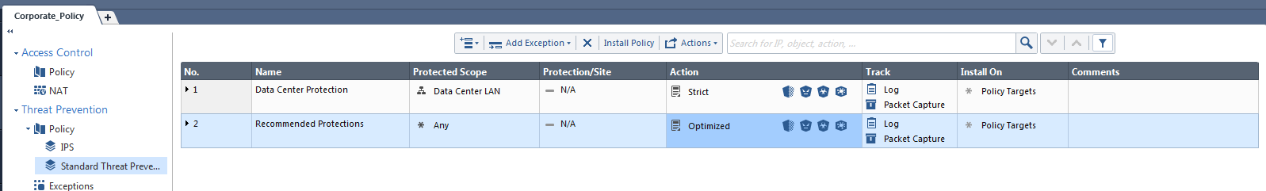

Slide 29

EFFCTIVE THREAT PREVENTION IS
BASED ON INTELLIGENCE
[Confidential] For designated groups and individuals

Slide 30
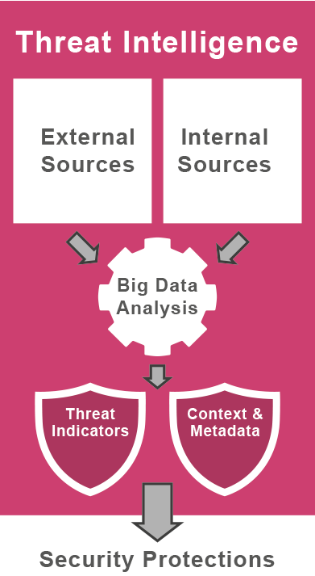
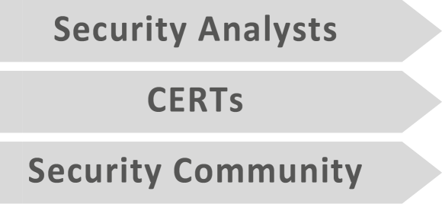
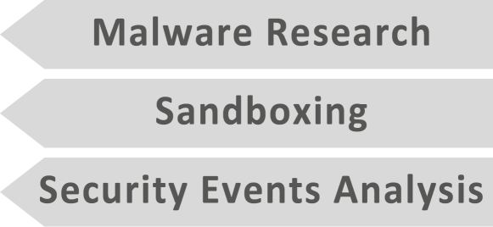
THREAT INTELLIGENCE
REAL-TIME collaborative and open INTELLIGENCE
translate into SECURITY protections.

Slide 31
MANAGEMENT LAYER
The MANAGEMENT Layer ORCHESTRATES the
infrastructure and brings the highest
degree of AGILITY to the entire architecture.
[Confidential] For designated groups and individuals

Slide 32
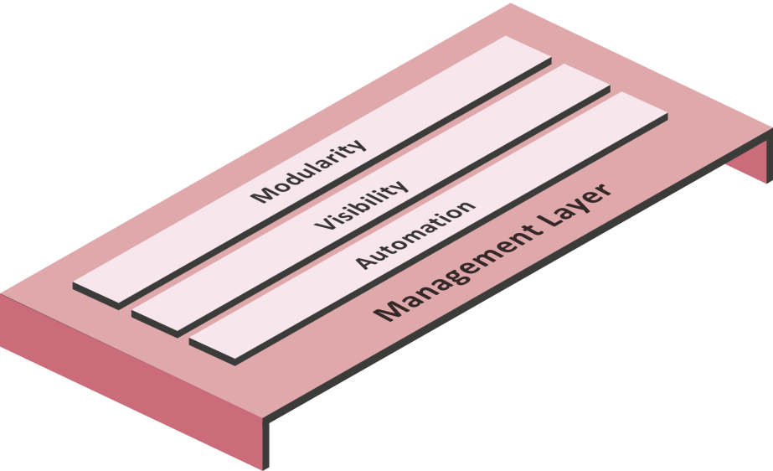
MANAGEMENT LAYER
BRINGS the SDP architecture to LIFE by integrating security
with business processes
MODULARITY
Support segmentation and segregation of management duties
AUTOMATION
Automates security policy administration and synchronizes it with other systems
VISIBILITY
360 degree situational awareness

Slide 33
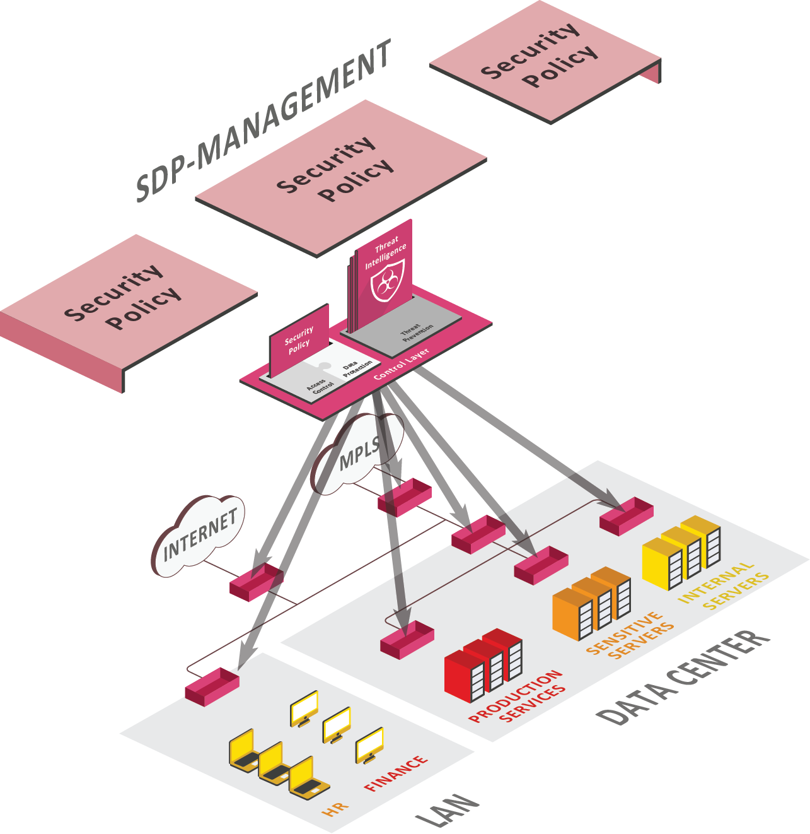
MODULARITY
ENDLESS FLEXIBILITY with LAYERS of POLICIES
Management modularity
provides the flexibility
to manage each
segment and control
Segregation of duties
Layers of policy

Slide 34
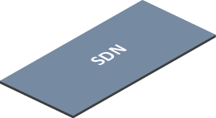

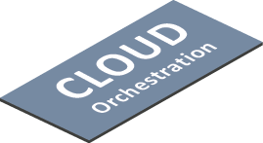
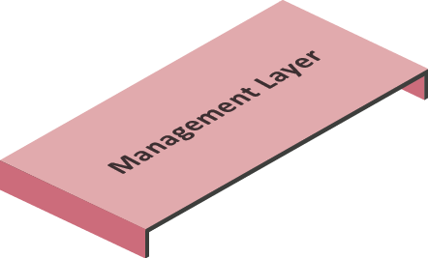
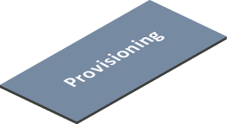
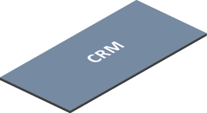
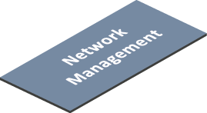
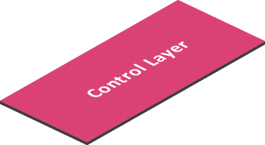

AUTOMATION
OPEN INTERFACES support business process changes
Open API
Web services

Slide 35
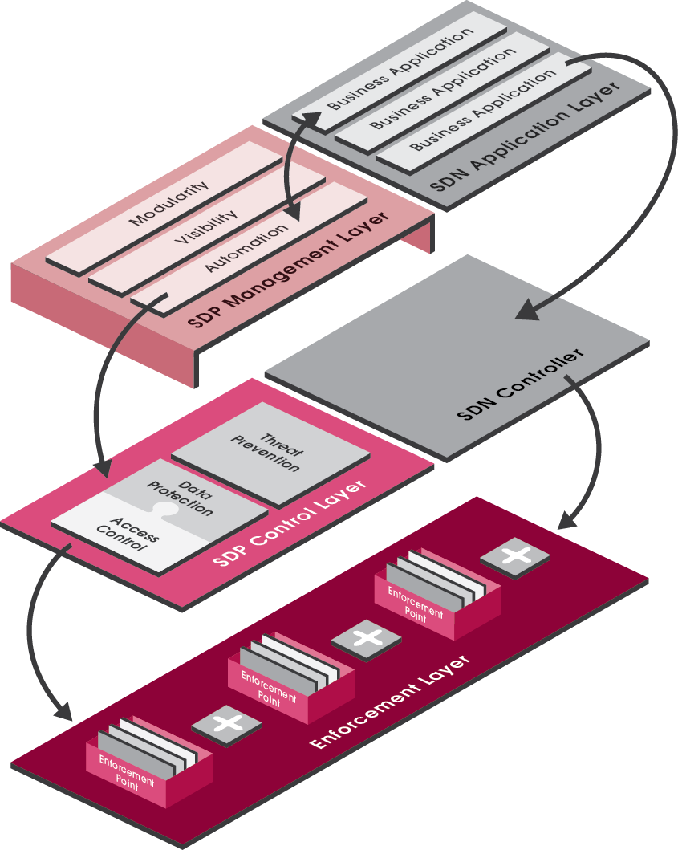
SDP AND SDN WORKING
IN SYNERGY
SDN
An emerging network architecture, decoupling
network control and data planes.
Data flows between network nodes controlled via
a programmable network SDN controller.
SDP
An overlay architecture enforcing security
traffic flows within an SDN network
Data flows are programmed to pass through
SDP enforcement points

Slide 36
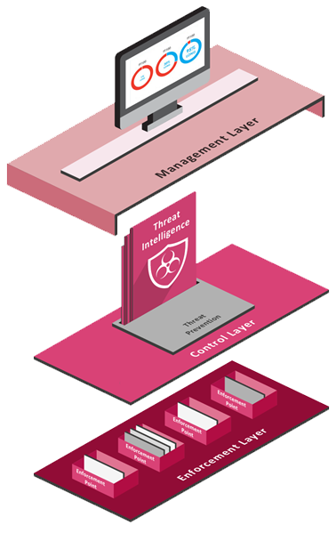
VISIBILITY
SITUATION AWARENESS & INCIDENT RESPONSE
Collects information from
every enforcement point
Situation awareness view
Generation of new protections

Slide 37

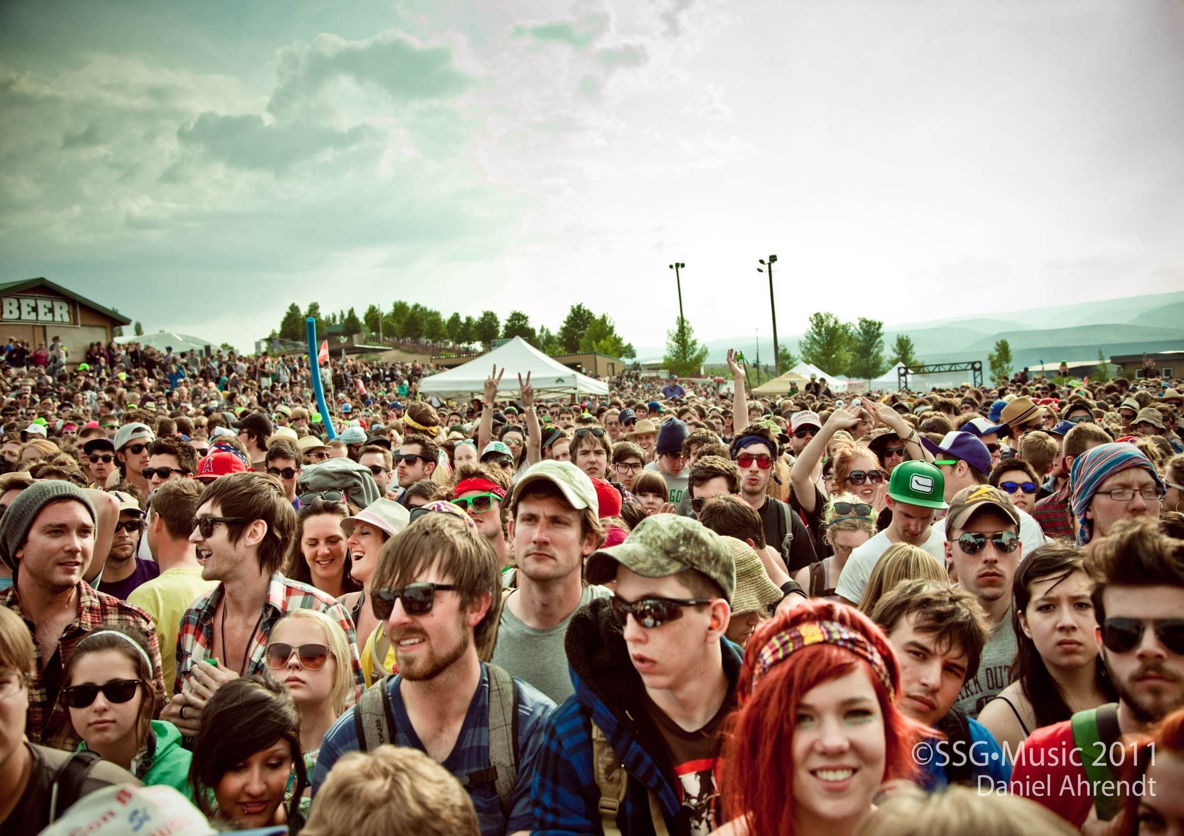
Notes:
In some organizations they only see parts of the picture

Slide 38
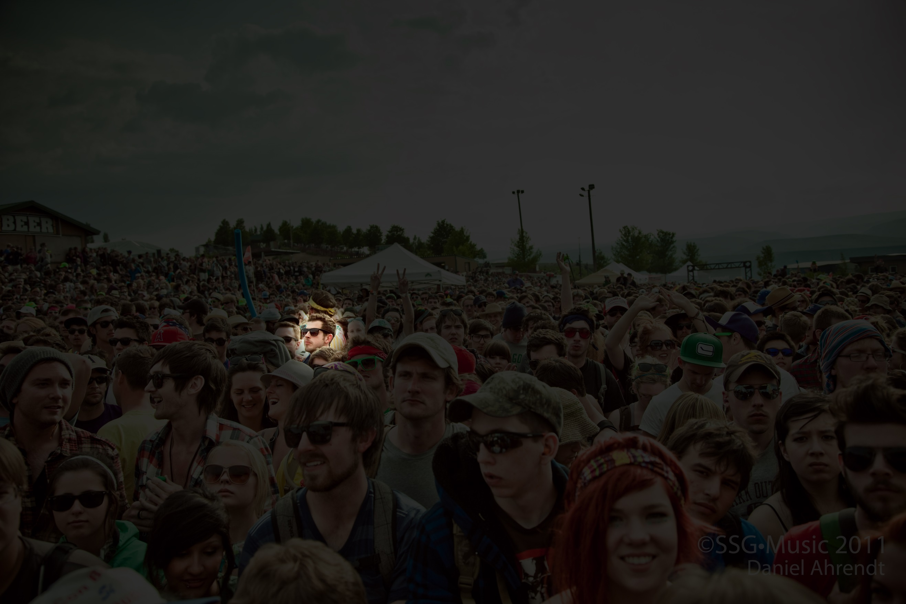
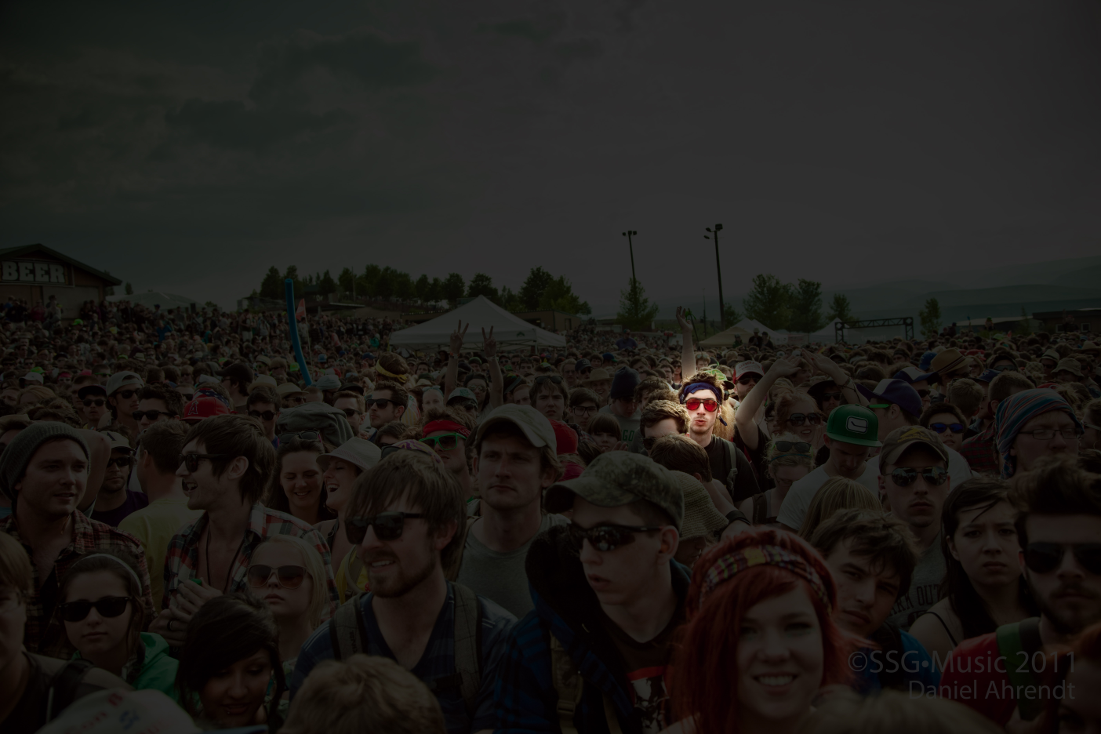
Notes:
In others they see everything but they do not understand what they see
Click:
R80 is showing organizations the full picture and informs them about REAL, RELEVANT threats as they occur providing organizations visibility, allowing the business to “fight through” attacks as well as enabled them to follow-up
Investigate and report.

Slide 39
SUMMARY
[Confidential] For designated groups and individuals

Slide 40
SOFTWARE – DEFINED PROTECTION
MODULAR AND DYNAMIC SECURITY
ARCHITECTURE
FAST AND RELIABLE ENFORCEMENT WITH
REAL-TIME INTELLIGENCE
TODAY’S SECURITY ARCHITECTURE FOR
TOMORROW’S THREATS
[Confidential] For designated groups and individuals

Slide 41
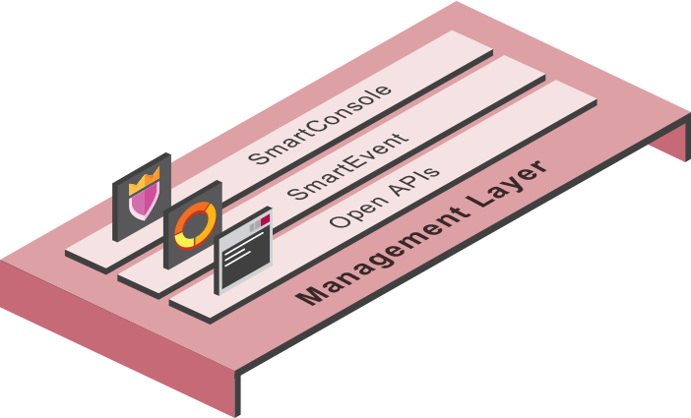
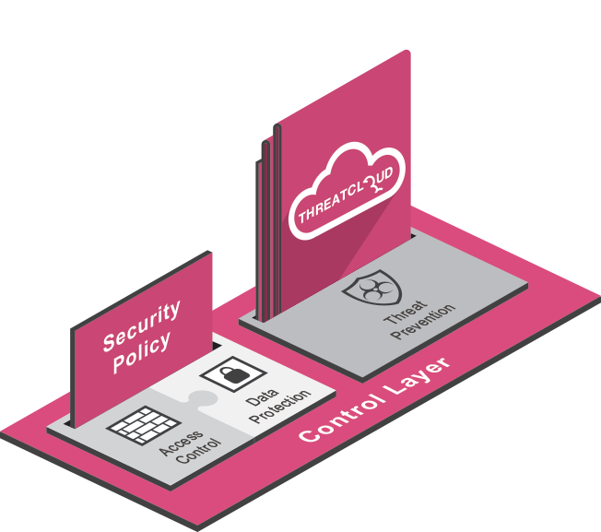
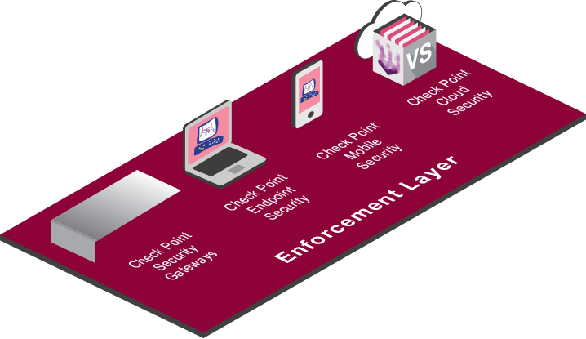
CHECK POINT
SOFTWARE – DEFINED PROTECTION
MANAGEMENT LAYER
Check Point Next Generation Security Management
CONTROL LAYER
Next Generation Firewall, Threat Prevention, ThreatCloud™
ENFORCEMENT LAYER
Network, Host, Mobile, Cloud

Slide 42
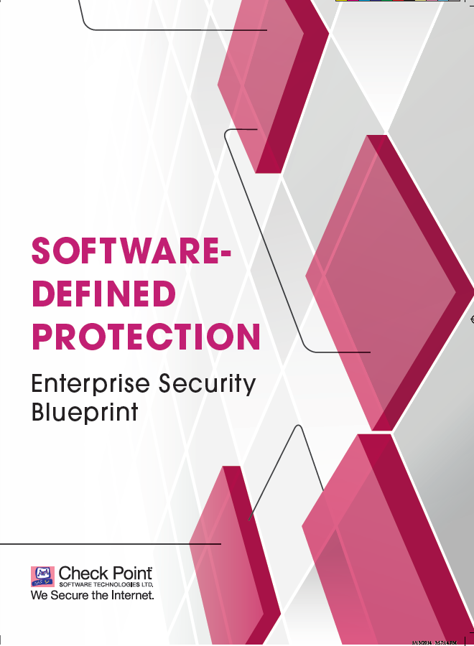
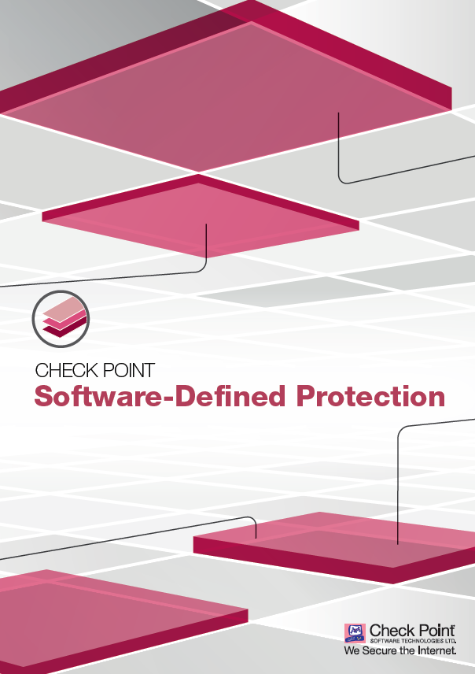
GO TO WWW.checkpoint.com/sdp
TO DOWNLOAD THE WHITE PAPER
[Confidential] For designated groups and individuals
Notes:
1. BUILD ATOMIC SEGMENTS - a set of computing hosts and networking elements that share a common security profile.

