Slide 1
Nya tider – Nya hot
En säkerhetsresa från gammalt till nytt

Slide 2
AGENDA
Grundläggande problem inom säkerhet
Nya arbetssätt
Traditionella skyddsmekanismer
Nya säkerhetslösningar
Nya hot
Bankerna i frontlinjen
Nya säkerhetslösningar igen
Nya hot igen
Notes:
Olika erfarenheter och expertis i rummet
Ska försöka ge alla något nytt ☺

Slide 3
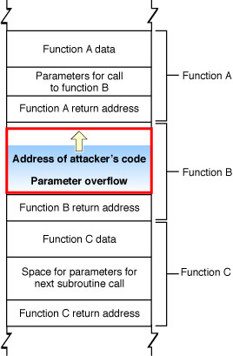
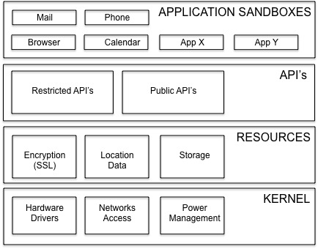
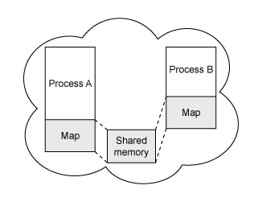
GRUNDLÄGGANDE PROBLEM
Buffer Overflow
Shared Memory
Mobilernas intåg i vardagen…
Grundläggande skillnader i arkitektur…
…men, resultatet hittills kanske inte det väntade
(Note: issue of scale… DDoS, Mobiltrafik, Code Injects…)

Slide 4
NYA ARBETSSÄTT
Mobilerna har drivit fram fler applikationer
Det har blivit enklare att utveckla
Inte nödvändigtvis säkerhetskunniga utvecklare
Mobilerna klarar det, men vanliga datorer gör det inte
Med 40-50 miljoner rader kod bara i Windows och 2 miljarder rader kod från Google…
Så mycket fler applikationer med sårbarheter, och samma “shared memory” som tidigare
Nära 1 miljon nya malware varje dag under 2015
Varje år upptäcks fler nya malware än alla tidigare år sammantaget
Notes:
Olika erfarenheter och expertis i rummet
Ska försöka ge alla något nytt ☺

Slide 5
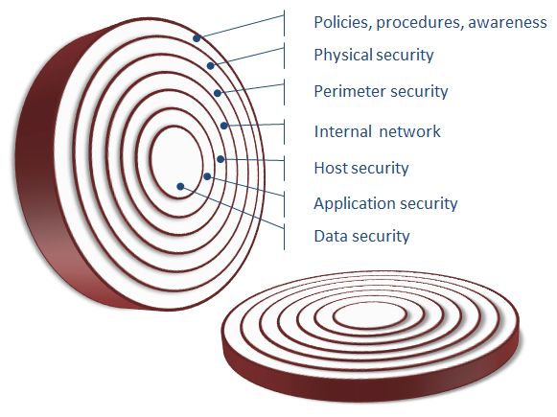
TRADITIONELLA SÄKERHETSMEKANISMER
Bygga säkerhet i “lager”
Dela in säkerhet i “domäner”
Host security…
Whitelisting / Blacklisting
AntiMalware
Just nu vinner vi inte slaget om host security
Hackare och kriminella kan idag “välja” att gå förbi säkerhetskontroller och AntiMalware-skydd på hostnivå

Slide 6





NYA SÄKERHETSLÖSNINGAR
Nya “lager” – Policy Decision Point, Policy Enforcement Point
Flytta säkerheten till “backend”
Meddela inte användaren eller sessionen om problem
4
REMEDIATE
2
ENFORCE
Bank’s
Line of Business / Fraud department
User
Session
Authentication
and prevention
Session
Applications
Management
Session & device data
Session risk assessment
Policy
3
INVESTIGATE
Management
1
DETECT
Case info
Case
Management
Detect and Analyze
Notes:
Olika erfarenheter och expertis i rummet
Ska försöka ge alla något nytt ☺

Slide 7
NYA SÄKERHETSLÖSNINGAR
Bankerna i frontlinjen
Hackare följer pengarna
Just nu är banker i frontlinjen av säkerhet
Bankernas säkerhetsmodell generellt har blivit…
“assume infected”
Påverkar något “den här sessionen”?
Industri och statbaserade attacker (senare)
Statsfinansierat
Equation Group
Notes:
Olika erfarenheter och expertis i rummet
Ska försöka ge alla något nytt ☺

Slide 8



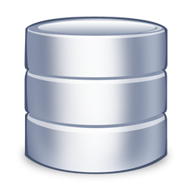

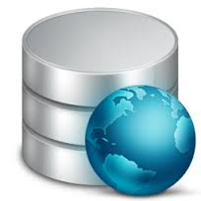
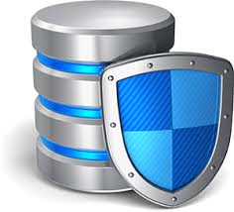
NYA SÄKERHETSLÖSNINGAR
Cloud
BankID
(IBM) Biometrics, Analytics, Watson…
sub
sub
INTERNET
Online
Banking
Notes:
Olika erfarenheter och expertis i rummet
Ska försöka ge alla något nytt ☺

Slide 9






Proxy looks like banking site
Asks user to authenticate
Displays “please wait” to user
Criminal now controls the session
Bugat
Dridex
Dyre
Shifu
2
Criminal
Criminal proxy
User machine connects to Online Banking Application
Asks user to authenticate again if necessary
4
1
User tries to connects to Online Banking Application
Malware redirects to criminal proxy
INTERNET
End user machine
3
Criminal proxies traffic back through user machine using VNC (MitB) or browser (MitM)
Now looks like legitimate user traffic
End user still in “please wait” mode
Online Banking

Slide 10
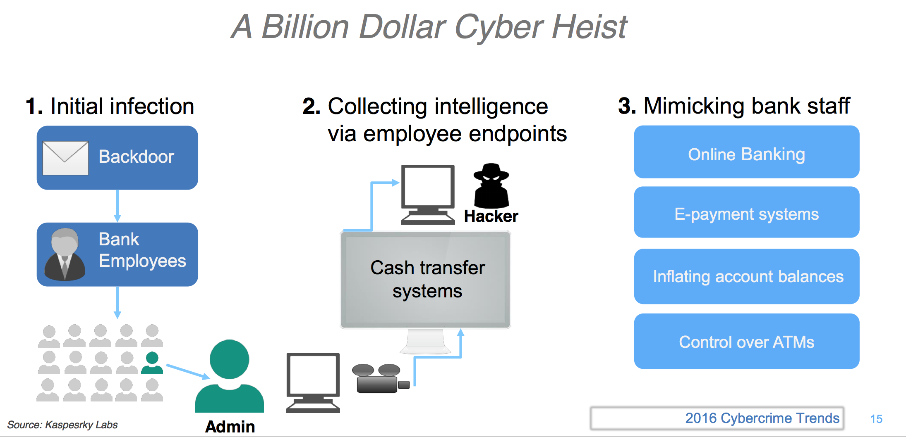
CARBANAK

Slide 11
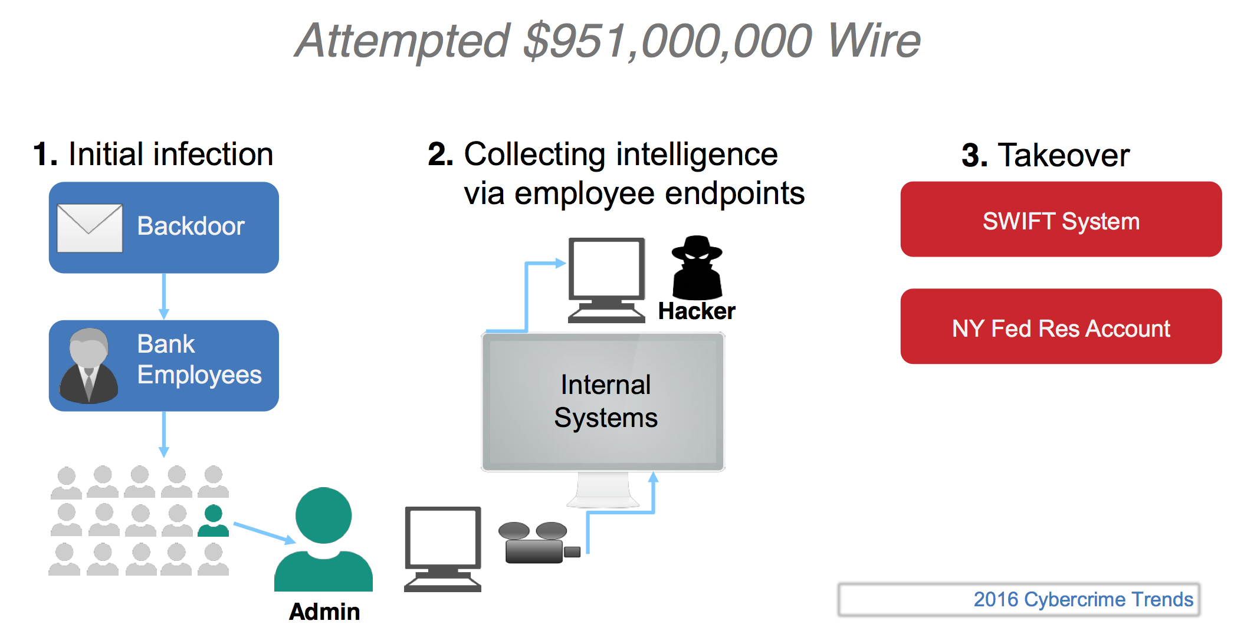
CARBANAK 2.0

Slide 12
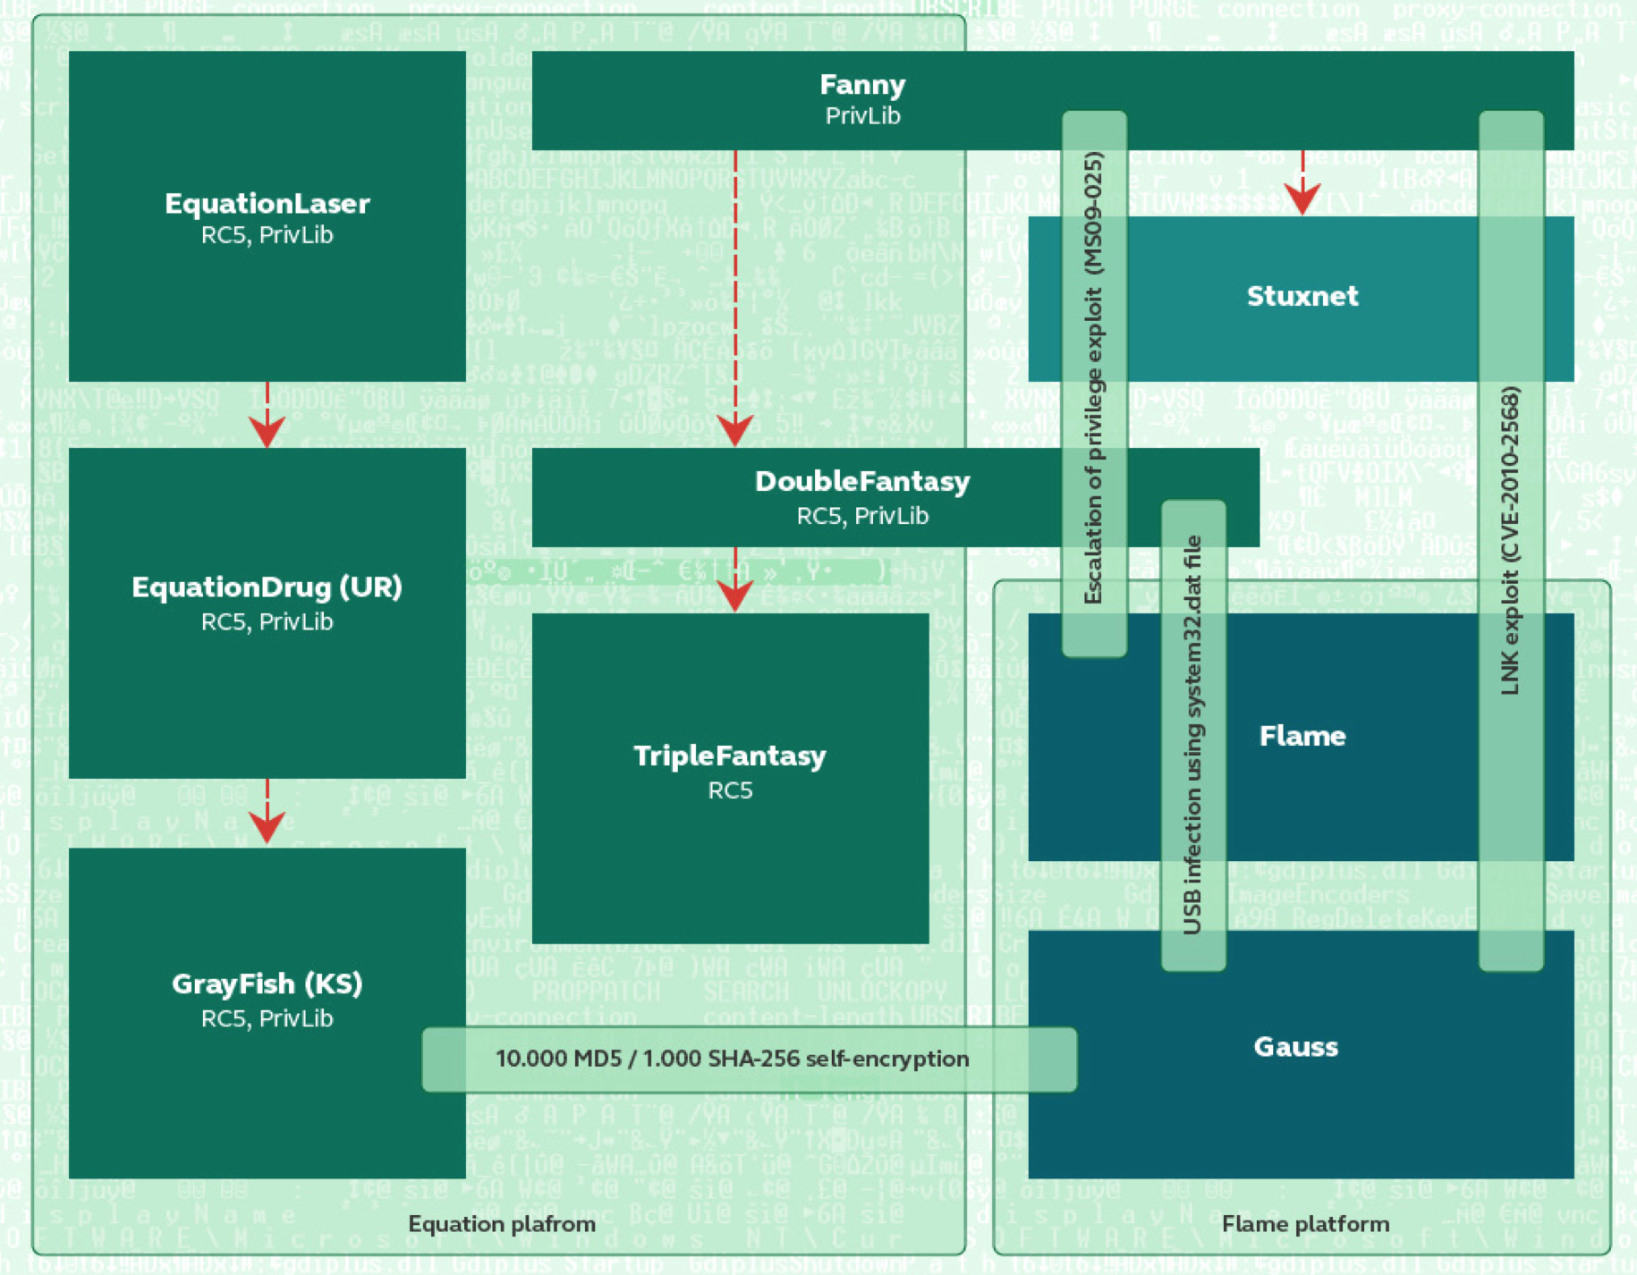
EQUATION GROUP

Slide 13
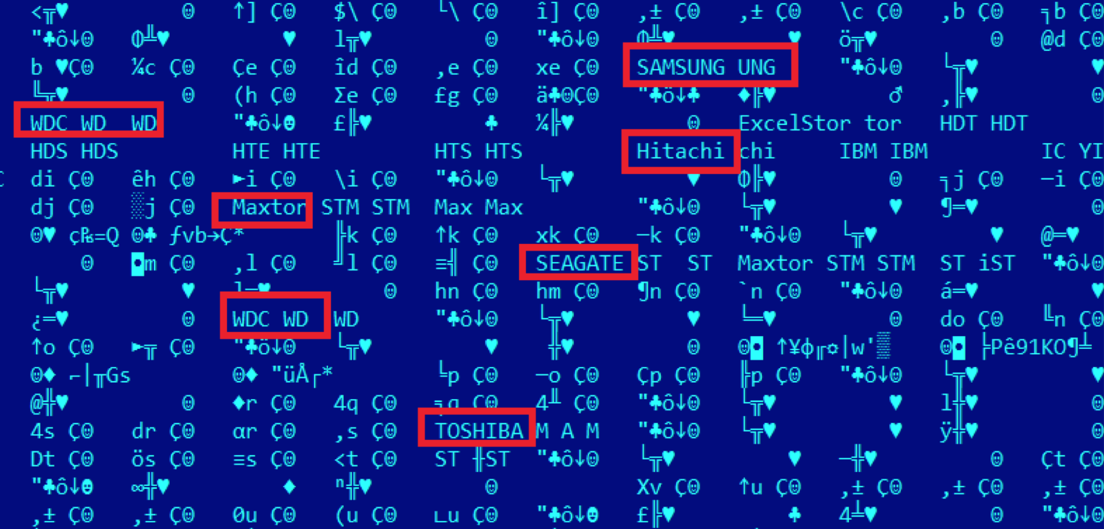
EQUATION GROUP

Slide 14



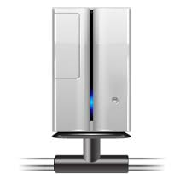


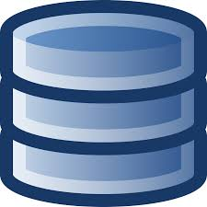






FINANCIAL TRANSACTIONS
Cards
ACH
SEPA
SWIFT
Securities
Domestic
Notes:
Speaker notes:
So what requirements do banks have on their systems and the data they generate?
Top left:
Banks are increasingly interested in advanced analytics on their data.
Which services do customers like?
What are the trends and can we steal customers from our competitors by serving the trend?
Who are my best customers?
Etc…
Top right:
Analytics on structured AND unstructured data is becoming more important.
More than 85% of data is unstructured and it can be a competitive edge in many areas to be able to use it.
Bottom left:
Security requirements…
Who is my customer, who are they associated with, where are they and where are their associations?
Is it really my customer making this transaction?
Is malware affecting the transaction?
Is the transaction Money Laundering?
Is this card transaction ok, is the customer in the same place as the card, etc…
Bottom right:
How is my service doing?
Can I deal with a potential outage before it happens?
Can I speed up the user experience?
Where are the bottle necks?
Out of these requirements, AML (Anti Money Laundering) and Cards stand out.
The simple reason is that both of these are costing serious money for the banks.
AML is costing money in pure operations.
It is a MUST for banks to perform AML checks and they must prove that they follow up on each Alert
Without advanced analytics (which most banks don’t have) AML produces massive false positives (98% or more is very common).
This means they are spending money on following up false AML cases (thousands of them) and still risk a fine for not dealing with their backlog
Fines in this area are heavy (driven by the fight against terrorist funding) and the banks feel this pain
Cards is mainly a matter of convenience, but is also costing serious money:
It is in the banks interest that we use our cards more, so they allow Card Not Present, international charges, etc…
Western European credit card numbers are high value in the underground
For Nordic banks, credit cards account for nearly all of the losses to fraud (AML is operational cost, not loss, but still money ☺

Slide 15
NYA HOT IGEN
Ta sej förbi 2FA
Kriminella använder spårning och “analytics”.
Notes:
Olika erfarenheter och expertis i rummet
Ska försöka ge alla något nytt ☺

